Slide 1
4th BrightnESS Best Practice Workshop
VAT exposure related to ESS Installations in Sweden
Carlo J. Bocchetta

Slide 2
6 work packages
36 months
11 countries
€20 M
18 European partners
Started August 2015: EU-funded project within the European Commission’s Horizon 2020 Research and Innovation Program

Slide 3
OBJECTIVES
BrightnESS serves as a risk mitigation tool in the delicate process of becoming fully operational
In-kind contribution
The knowledge and skills of European companies, and institutes, are best deployed in In-Kind Contributions.*
Technical performance
The highest technical performance is obtained from the ESS target, moderators* and detectors in order to deliver world class science.
Increase innovation impact
The innovation impact of ESS will be increased through TTO, ILO, PCP activities, and through sustainability measures supporting the ERIC, new members and future user communities.
*Based on ESFRI recommendation and the ESS risk register

Slide 4
- Work Plan & Management Structure
ESS, STFC, FZJ, CEA, ESS-Bilbao, Wigner, INFN, TUD
Today
ESS, STFC, FZJ, CEA, ESS-Bilbao, Wigner, INFN, TUD

Slide 5


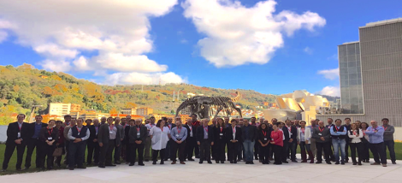
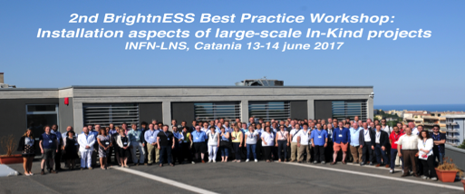
WP2.3 - Development of IKC 'Best Practice' system and organisation of collaboration meetings
First Workshop
Second Workshop
The Best Practice workshops are organised by ESS in collaboration with Elettra, the technical and administrative groups at the ESS and with input from the Field Coordinators (Partners).
Maximize the common knowledge of how to best execute IKC activities.
Establish standard approaches for the implementation of technical and administrative scope.
Three events have been organized and this is the fourth.
1st BrightnESS Best Practice Workshop: Engineering aspects of large-scale In-Kind projects
100+ attendees
80+ attendees
Engineering aspects of large-scale In-Kind projects
14-15 November 2016, ESS-Bilbao, Bilbao, Spain
Installation aspects of large-scale In-Kind projects
13-14 June 2017, INFN-LNS, Catania, Italy

Slide 6
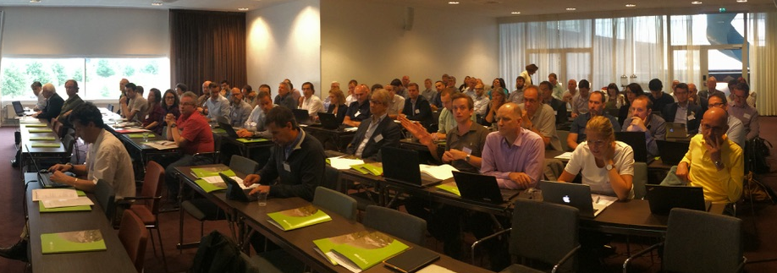
WP2.3 - Development of IKC 'Best Practice' system and organisation of collaboration meetings
The Best Practice workshops are organised by ESS in collaboration with Elettra, the technical and administrative groups at the ESS and with input from the Field Coordinators (Partners).
Maximize the common knowledge of how to best execute IKC activities.
Establish standard approaches for the implementation of technical and administrative scope.
Three events have been organized and this is the fourth.
Third Workshop
Fourth Workshop
100+ attendees
40+ attendees
Detailing the European Spallation Source In-Kind Installations: Organization, Plans and Support
19-20 June 2018, ESS, Lund, Sweden
VAT exposure related to ESS Installations in Sweden
4 July 2018, ESS, Lund, Sweden,

Slide 7
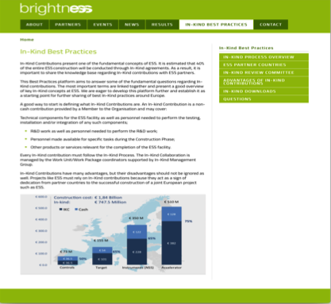
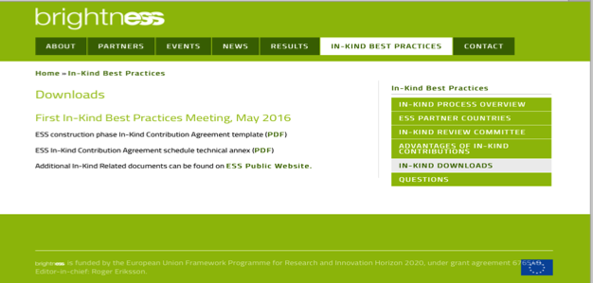
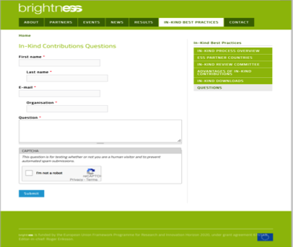
WP2.3 - Development of IKC 'Best Practice' system and organisation of collaboration meetings
WEB Page: https://brightness.esss.se/in-kind-best-practices/in-kind-process-overview

Slide 8
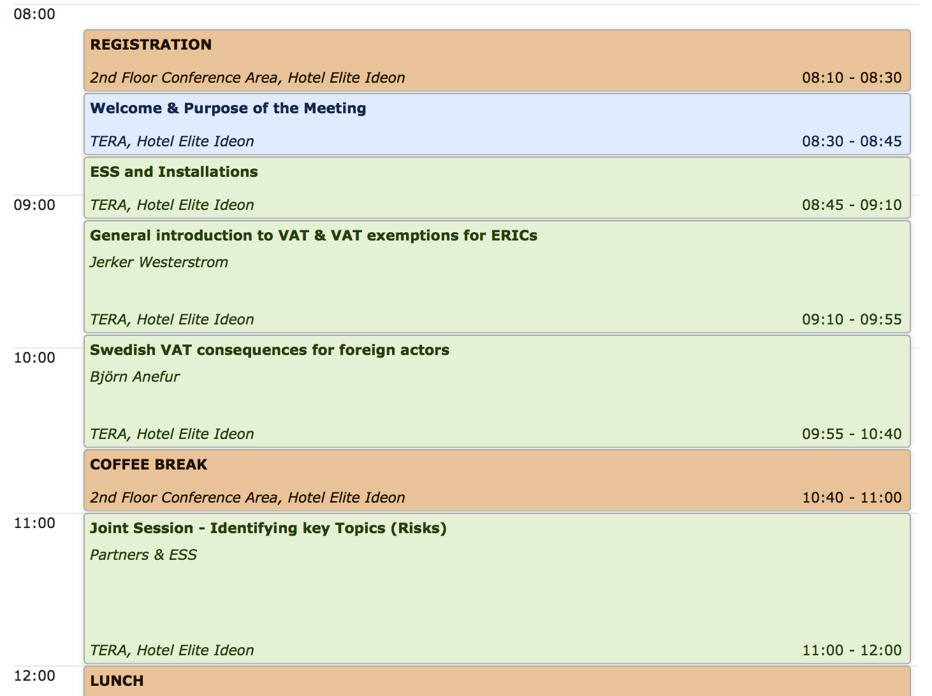
4th BrightnESS Best Practice Workshop
VAT exposure related to ESS Installations in Sweden
https://indico.esss.lu.se/event/1062/
password: VATESS
Introductory talks for context of meeting and to start off discussions.
Session for you to air your situations, concerns,
questions, etc…

Slide 9
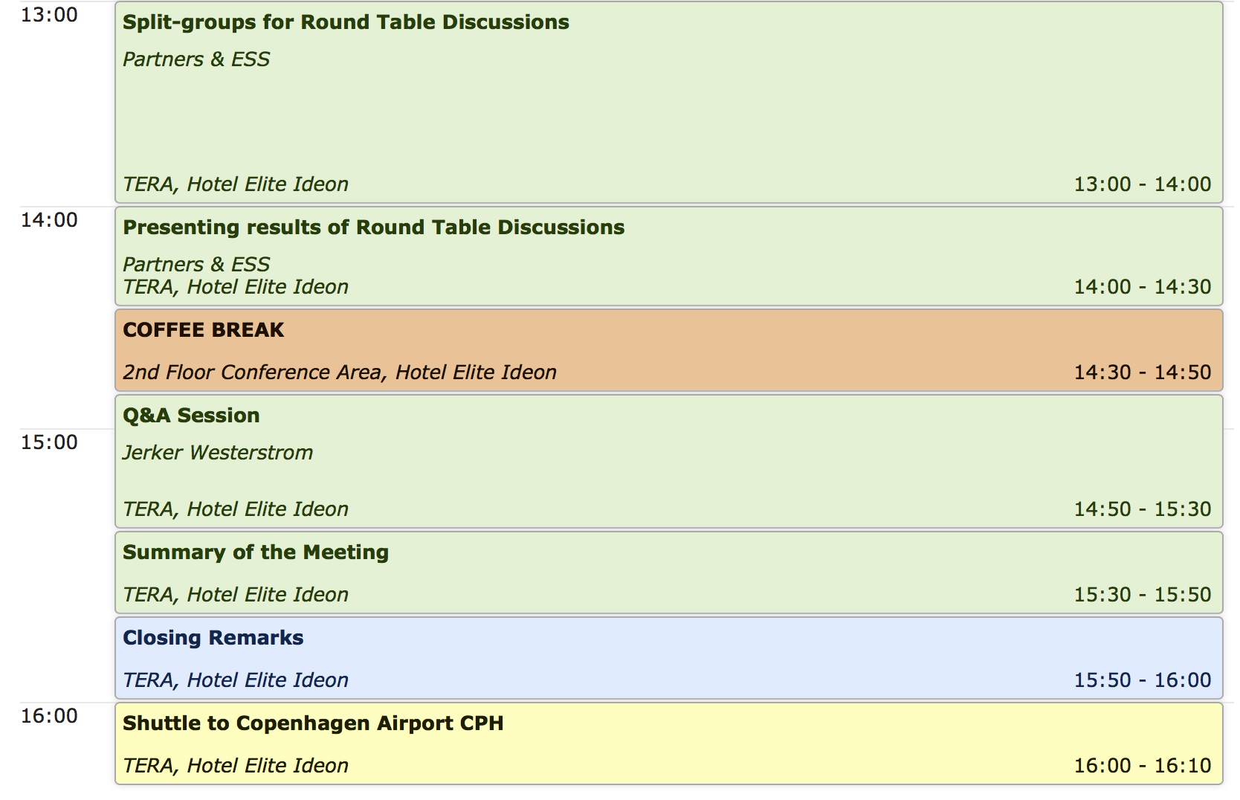
4th BrightnESS Best Practice Workshop
VAT exposure related to ESS Installations in Sweden
We split into groups for discussion, reaching understanding and presenting results. Take notes!
Time for collective discussion
https://indico.esss.lu.se/event/1062/
password: VATESS

Slide 10
Focus of today’s workshop
What is happening at ESS in terms of installations
Overview of VAT
VAT implications in Sweden for foreign entities
Go through “Guideline on possible VAT risks in Sweden for in kind partners”
Working groups to discuss the Guideline
Q&A session
Closeout
VAT exemption of Members of ERICs
VAT exemption of ERICs

Slide 11
Thank You

